Slide 1
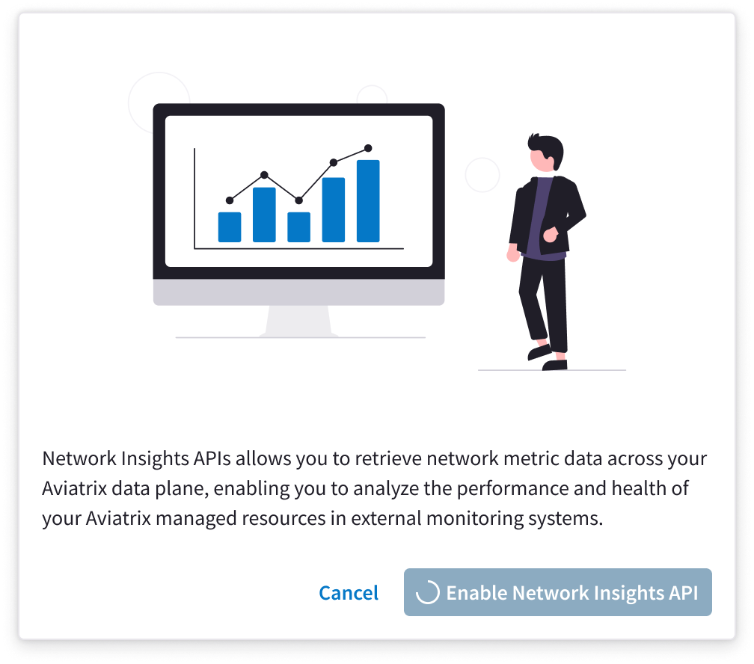
Network Insights API: Overview
Network Insights API provides an API-driven way to access the rich data and telemetry that the Aviatrix solution makes available by being part of your data plane
Network Insights API supports multiple data visualization tools such as Grafana, DataDog, and New Relic powered by the Prometheus database

Slide 2
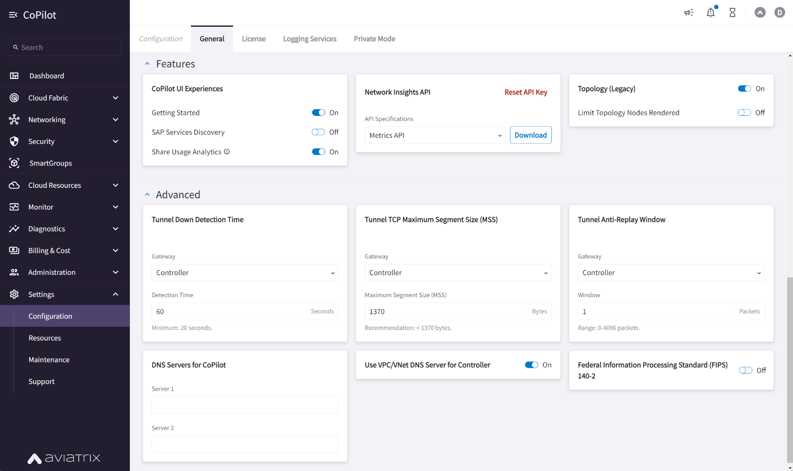
Network Insights API: How It Works
Network Insights API is activated from CoPilot
The API key is generated from CoPilot and made available to include as authentication in an API call
This key can be rotated and revoked as needed and a new one generated
Aviatrix Gateways deliver the telemetry to the Aviatrix Controller and CoPilot reads this data at an interval to a database
When an API call is made, CoPilot makes available the data and caches the data for 5 minutes. Multiple API calls will not overwhelm the API but the data is continuously recorded and updated for the next interval

Slide 3
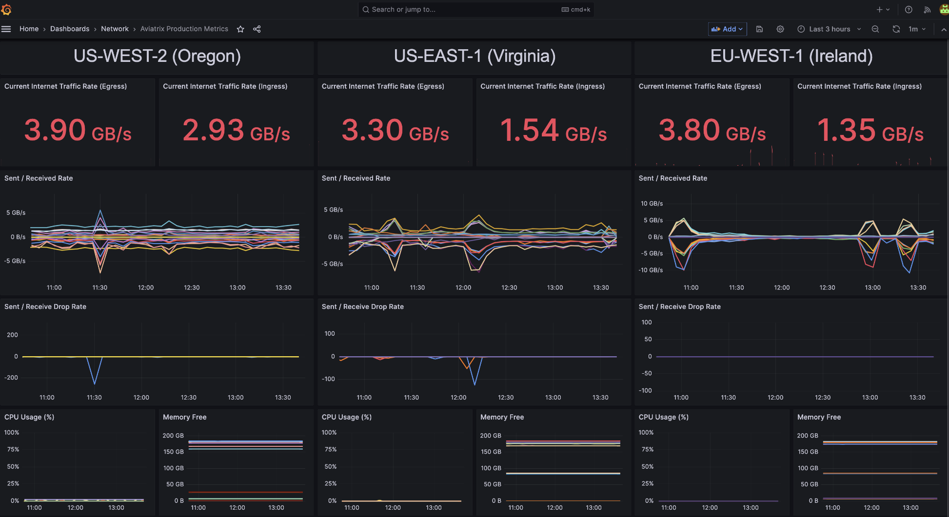
Network Insights API: Grafana Example
Using in-depth Aviatrix telemetry and integrating with a mature data visualization tool gives unparalleled capabilities to Operations and Planning teams to both monitor the current state of the network and use trends of data to plan future expansion

Slide 4
Demo
https://cplt.demo.aviatrixtest.com/#/login
https://grafana.demo.aviatrixtest.com/login

